Slide 1
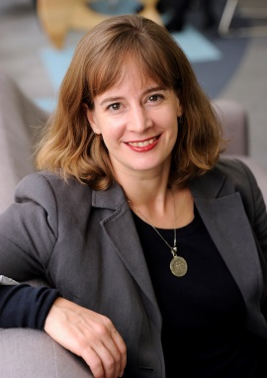
How to you establish and manage your personal brand?
For the Government Women’s Network
with Jane Hodgen
Inclusion, Diversity and Leadership Development - Asia Pacific, TCS
15 Oct 2019
External

Slide 2
Today…
Reflect
Reflect on your personal brand
Move from Subconscious to Conscious
I am
I do
Being your Authentic self
Me
My Values
If I were a product
My statement
As a women…
My take away…

Slide 3
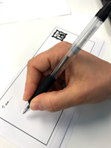
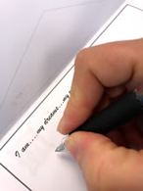
Envelope Exercise
You choose where to write…
Front of the envelope, back of the envelope or inside the envelop
Imagine you are sending this to your future self. Fill it with words, images as you like to illustrate who you are, what is important to you and what you hope for.

Slide 4
What happens when values are /aren’t aligned
My Values
When Values ARE Align:
Job satisfaction
Work better
Feel aligned and moving forward
My Organisation’s Values
My
co-workers/ Boss’
Values
Stay with the company
Happier in work and life
My Department/ Role’s Values
When Value ARE NOT Aligned:
Low in energy
Feel Stressed
Frustrated with your work
Want to resign/ find a new job
Don’t want to go to work
Damaged work relationships

Slide 5
Personal Value Contribution
Examples of how we provide Personal Value Contribution to each other
I value…
This helps me…
Role Promotion
Visibility
Quality of Life
Friendship
Acceptance
Attention
Self Development
Exposure
Fun
Entertainment
Family
Useful Contacts

Slide 6
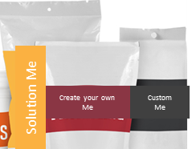
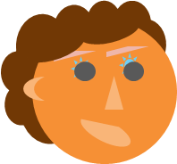
If I was a product…
If I was a product to maximise profit?
My authentic self?
What is my Unique Selling Proposition?
What is unique about me?
How would my product “look”?
How would I like to appear if the world didn’t have expectations?
What value would I bring?
What value does my authentic self I bring?
How would my product “look”?
How do I appear to others when I am my authentic self?
What are the potential risks of being to far on either side?

Slide 7
“Me” as a brand
My personal values
What I feel I stand for / represent
Behaviours I feel
I need to exhibit as brand “me”
What does this mean for the kind of work I do and the type of role I do.
(a) now and (b) in the future

Slide 8
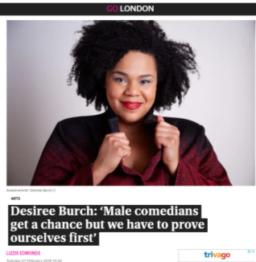
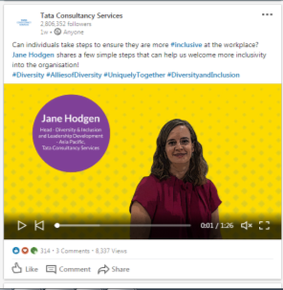
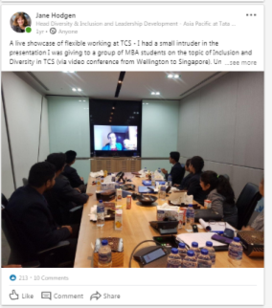
As a woman…
Speaking styles
“Proving” yourself
How do I appear?
Do we speak as directly?
Do we ask for what we want?
Ask for permission or forgiveness?
Do we believe we can do the role
Is it true that we need to prove ourselves more than men?
“You don’t need to be the tough girl”
Does appearance matter?
Owning the space.
What about my online presence?
What about family?
How are we consciously behaving?

Slide 9
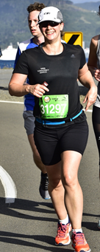
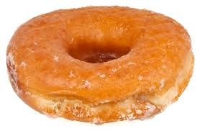
My key take away
To be my authentic self and ensure I am establishing and managing my brand:
These are the three things I want to change or introduce in my day to day life.
I will practice these for at least 15 minutes a day.
Top 3 things I want to implement:
or
⬧

Slide 10
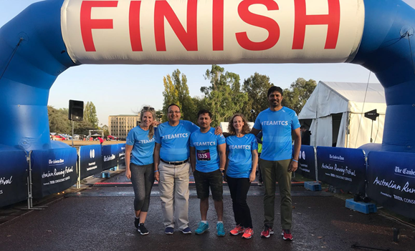
Now it is…
the time to establish and manage your personal brand!

Slide 11
About your facilitator
Jane Hodgen,
Inclusion Diversity and Leadership Development Asia Pacific, TCS
With a passion for inclusion and diversity Jane has been running workshops with Clients and TCS associates for over 17 years on a wide spectrum of topics.
Her current role focuses on inclusive practices within TCS, building diversity across all layers of the organisation and supporting employees through their careers. From onboarding initiatives, future leadership building to building diversity and ally networks.
Jane drives remote teams to understand leadership needs and deliver offerings to benefit individuals and the organisation. Her role enables building diverse and inclusive leadership.
Jane has lived and worked in 6 countries, 3 nationalities (South African, New Zealand and British) and has travelled extensively.
She has over 18 years of experience across a wide range of HR/OD fields. Previously performed a variety of roles including Organisational Development Head - TCS Asia Pacific, Acting HR Head -TCS UK & Ireland and Head of Talent Management - TCS UK & Ireland.
Jane holds a Commerce and Science degree from Victoria University, Wellington in Psychology, Management and Marketing. She has a 3 year old and a 5 year old. Her passions include running, hiking and yoga.

